Slide 1
MODEL FORMULATION AND PREDICTION
Daman Virdi

Slide 2
HAND WRITTEN DIGIT PREDICTION PROJECT
DAMAN VIRDI

Slide 3
TENSORFLOW
TensorFlow is a free and open-source software library for machine learning.
It particular focus on training and inference of deep neural networks.
Tensorflow is a symbolic math library based on dataflow and differentiable programming.

Slide 4
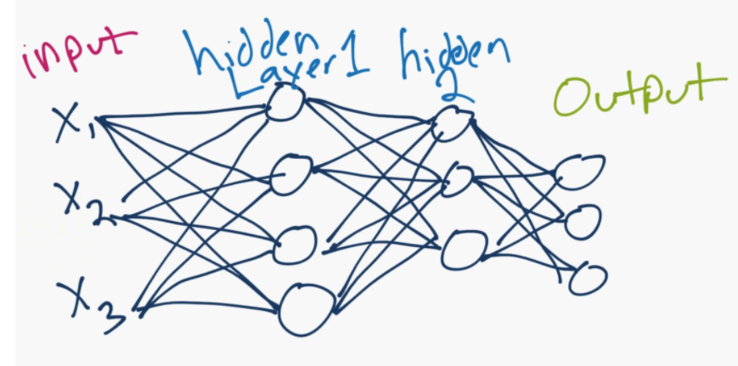
NEURAL NETWORK

Slide 5
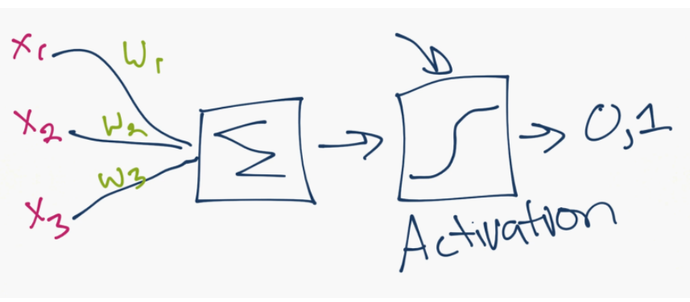
SINGLE NEURON

Slide 6
WHAT IS A TENSOR?
A multi- dimensional array

Slide 7
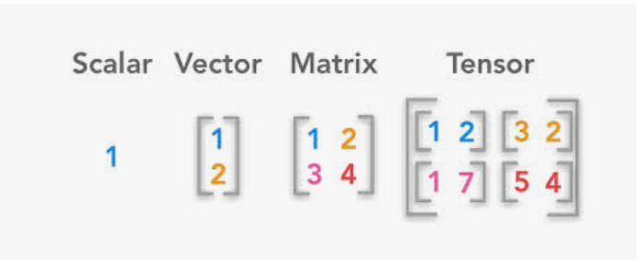

Slide 8
MNIST DATASET
It's a dataset of hand-written digits, 0 through 9.
It's 28x28 images of these hand-written digits.

Slide 9
STEPS
1. Importing the Libraries
2. Importing the dataset
3. Splitting the dataset into Training set and Test set
4. Training model on the training set
5. Predicting the Test set results
6. Visualizing the Test set result

